Slide 1
Welcome to CHS Curriculum Night!
Rachelle Abelson abelsonr@fultonschools.org
Abelsonr.weebly.com

Slide 2
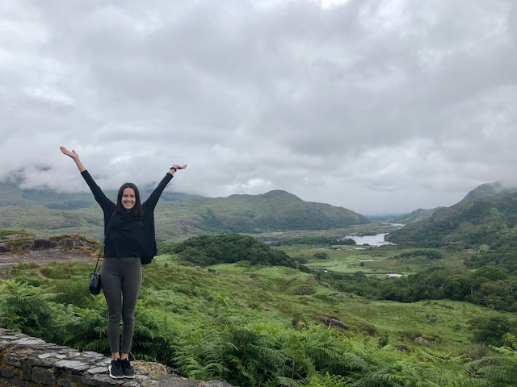
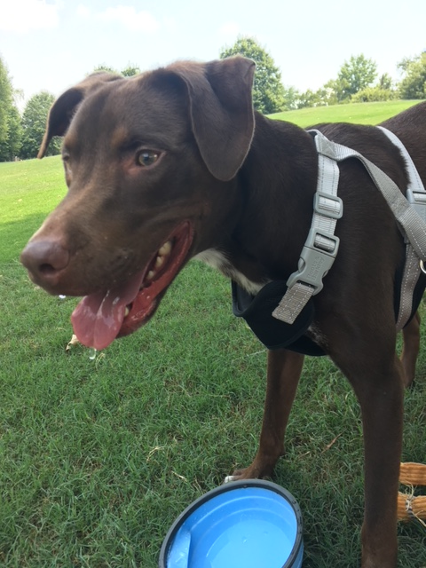
Who is Rachelle Abelson?
Ireland 2018
I am originally from Buffalo, NY- moved to Atlanta in 2016!
I received my Bachelor’s degree from The State University of New York at Cortland (Student taught in Syracuse, NY & Australia!)
I received my Master’s degree at The University of Pittsburgh
Things I love: Travel, dogs, Netflix, spending time with family/friends ☺
Crosby ☺

Slide 3
Course Syllabus (website: abelsonr.weebly.com )
Course Content
Supplies
Expectations
Extra help: 7:45-8:15am daily
Recovery

Slide 4
Class routine
Warm-up
Homework check – 1 weekly grade
Lesson activity with guided practice
Individual Practice/ HW

Slide 5
Student + Parent + teachers = success
Consistent Effort
Encouragement
Communication

Slide 6
Communication
Progress Reports/Infinite Campus
Remind!
Per. 1- Text “@1abelson” to 81010
Per. 2- Text “@2abelson” to 81010
Per. 4- Text “@4abelson” to 81010
Per. 6- Text “@6abelson” to 81010
Per. 7- Text “@7abelson” to 81010
E-mail: abelsonR@fultonschools.org

Slide 7
Thank you for being here and giving me the opportunity to work with your children!

